Slide 1
Environmental metagenomics
Working with the command line

Slide 2
UNIX
A family of computer operating systems (OSs)
Linux, MacOS, Solaris, OpenBSD
Key characteristics:
Multitasking
Multiple software processes can run at the same time
Multiuser
Several users can use the same computer at the same time
Multiprocessing
Capable of supporting and utilizing more than one computer processor
Portable
Can be used in various hardware architectures

Slide 3
The UNIX philosophy
“The idea that the power of a system comes more from the relationships among programs than from the programs themselves”
Use of plain text for storing data
Use of a hierarchical filesystem
Use of a large number of simple programs performing a limited, well-defined function
Use of a command-line interpreter (“shell”) to combine these programs to perform complex tasks

Slide 4
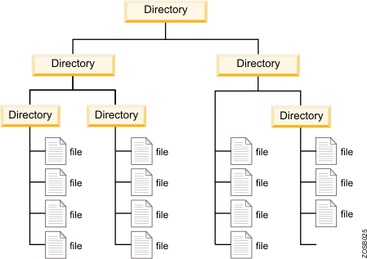
The UNIX hierarchical filesystem

Slide 5
The UNIX hierarchical filesystem
https://www.linux.com/sites/lcom/files/styles/rendered_file/public/standard-unix-filesystem-hierarchy.png?itok=CVqmyk6P

Slide 6
The UNIX hierarchical filesystem
/
bin
usr
home
bin
lib
Documents
Downloads
Pictures
Videos
Research
Teaching
MMB-114
/home/Documents/Teaching/MMB-114

Slide 7
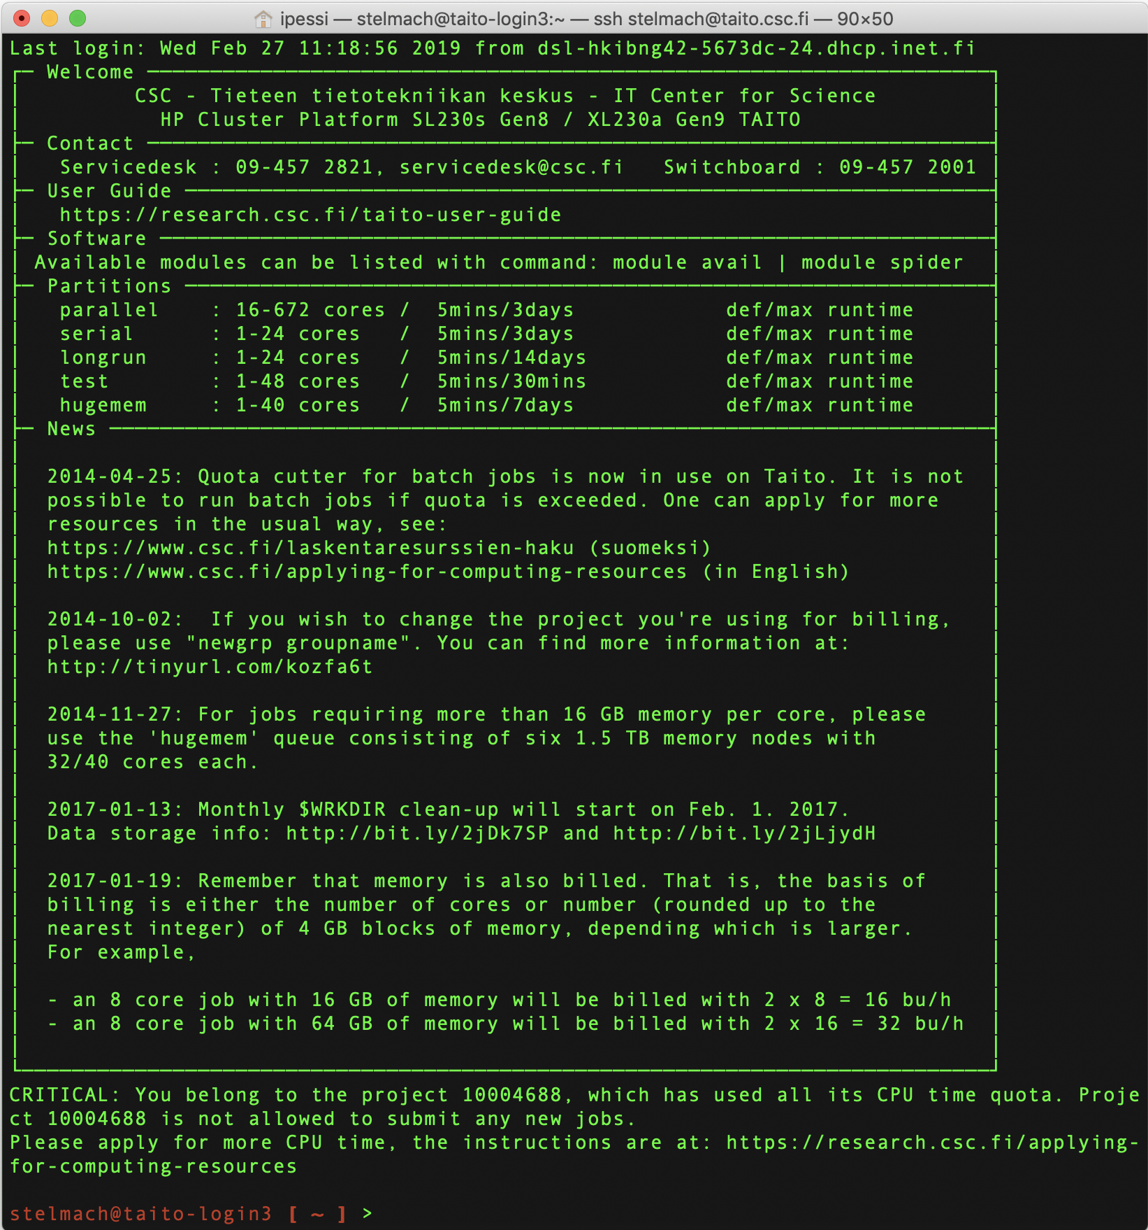
The UNIX shell
Command-line interpreter
Interprets sequences of text
Entered by a user
From a file
From a data stream
Primary interface before graphical user interfaces (GUIs) appeared
Still widely used today
Efficient
Low memory footprint
Advanced scripting

Slide 8
Some basic UNIX commands
pwd: print working directory (“where am I?”)
ls: list (“show folder contents”)
mkdir: make directory (a.k.a. folder)
cd: change directory (“go to folder”)
cp: copy
mv: move
rm: remove

Slide 9
Some additional notes
Case-sensitive
photo.jpg ≠ PHOTO.jpg
Does not like spaces and special characters in file/folder names
genome report.txt ❌
genome_report.txt ✅
väitöskirja.txt ❌
vaitoskirja.txt ✅
Space after each “word” in the command
Commands have to be typed in a single line, one at a time
After each command, hit “Enter” to execute it
Lines starting with “#” are comments
A few tricks:
Tabulator
History

Slide 10
How to learn UNIX?
By using it!
Trial and error
Don’t copy and paste it, type it
Ask the internet
http://stackoverflow.com/
http://stackexchange.com/
http://askubuntu.com/
Google!
Online courses/tutorials
http://codecademy.com
Cheat sheets
http://mally.stanford.edu/~sr/ computing/basic-unix.html
Manual (“man”) pages
man cutadapt

